Slide 1
What are Files
Types, Compression, encryption

Slide 2
Files - definition
A computer file is a collection of data stored on a computer storage device, identified by a unique name.
Files can store various types of information, such as documents, images, videos, programs, and other data, and are used for both user data and running programs.
These digital "packages" of data are read and manipulated by computer programs and can be moved, copied, and transferred between devices.

Slide 3

Computers use Binary
Remember that all data on a computer uses binary, therefore the data inside of files is also binary (Does this mean more math )
How does the O/S know which 1's and 0's represent a sound, a video, text, or a normal picture?
An operating system typically uses a combination of methods to determine a file's type, relying on metadata and internal data rather than deep content analysis.
File Extensions
Magic Numbers
File Metadata

Slide 4
File Extensions
The most common and basic method is checking the file extension (e.g., .txt, .jpg, .png, .gif). When you try to open a file, the OS often uses this extension to decide which application to use.
Example: A file named vacation.jpg is assumed to be a JPEG image, while notes.txt is treated as plain text.
Limitation: Extensions can be easily changed or absent, meaning this method isn't foolproof.

Slide 5
Magic Numbers
A more reliable method involves reading the first few bytes of the file, which often contain a "magic number" or file signature.
Images: Image formats have specific byte sequences at the very beginning that act as an identifier. For instance, most JPEG files start with the hexadecimal value FF D8 FF E0, and PNG files start with 89 50 4E 47 [1, 4]. The OS or an application can read these bytes to confirm the file type regardless of its extension.
Plain Text: Plain text files (like .txt or code files) typically lack these specific signatures. They usually begin immediately with printable characters, standard text encoding indicators (like a Unicode Byte Order Mark), or simply 0 bytes.

Slide 6
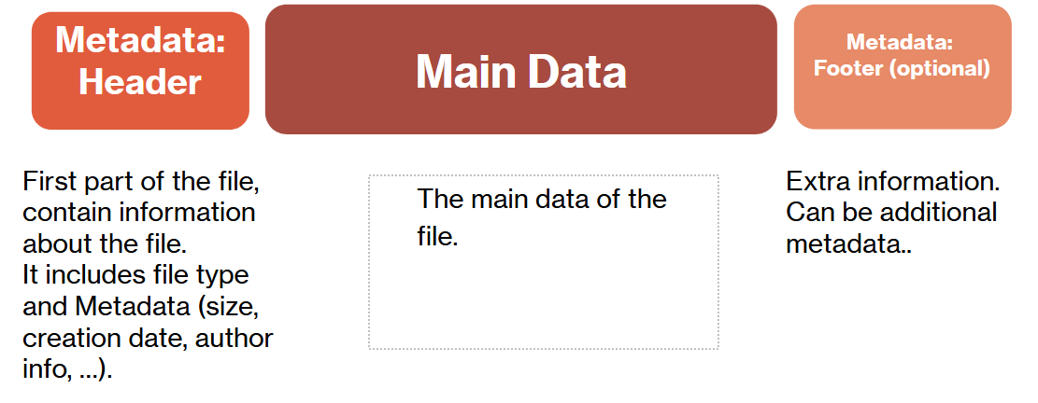
File Metadata and MIME Types
The operating system and file systems also store metadata about the file. Metadata is data about data.
In environments like macOS and Linux, the file command uses a database of magic numbers and file patterns to provide a more robust identification, often determining the file's MIME type (Multipurpose Internet Mail Extensions).
MIME Types help describe the content type, such as image/jpeg or text/plain, which applications use to handle the data appropriately.

Slide 7
File Types
A computer file type is a name for a specific kind of file, like a Microsoft Word document or a JPEG image, and is often identified by its file extension (e.g., .docx, .jpg).
The underlying structure of a file, which determines how the data is encoded and stored, is called the file format.
For example, the file type "JPEG image file" is associated with the .jpg extension, and its format specifies how image data is compressed and stored.
Some file types are standard and can be opened by many programs (e.g., Rich Text Format or .rtf), while others are proprietary and are primarily used by a specific application (e.g., .psd for Adobe Photoshop).

Slide 8
File Formats
Definition: The specific structure and organization of data within a file, dictating how it's encoded, stored, and interpreted.
Purpose: Different formats are designed for different purposes, such as prioritizing image quality, minimizing file size, or enabling specific functionalities.
Relationship to file types: The file format is the technical detail behind the file type. For instance, a .jpg file type uses the JPEG format to compress and store image data.
Types of formats: Some formats are designed for specific data, like .png for lossless images, while others are containers that can hold multiple types of data, such as Ogg files for video and audio.

Slide 9
File Metadata
Computer file metadata is data about data that describes a file's properties, such as its author, creation date, size, and location.
It also includes information about file history, revisions, and permissions.
Metadata helps with organizing, searching, and managing files, but it can also contain personal information that is automatically embedded in files and may be shared when the file is transferred.
Privacy and security considerations
Information sharing: Metadata can be inadvertently shared with others when a file is copied or sent, potentially revealing personal information.
Removing metadata: For privacy or security reasons, it is often advisable to remove or edit certain metadata before sharing a file.
Windows users can right-click a file, select Properties, go to the Details tab, and click Remove Properties and Personal Information to manage this data

Slide 10
How Data is Encoded
Data encoding is the process of converting data into a specific format for efficient storage, transmission, or processing.
It ensures data is compatible between systems and can be understood by algorithms.
It can protect data through encryption and /or make it more manageable with compression.
Examples include converting text into a standardized format like Unicode or transforming categorical data into numbers like one-hot or label encoding.

Slide 11
How Data is Encoded
PlainText files
Plain text files are encoded using character encoding schemes, where a sequence of bytes represents characters.
Historically, this was done using ASCII, but modern systems predominantly use Unicode-based encodings like UTF-8 or UTF-16 to support a wider range of characters from different languages.
While there is no standard way to indicate the encoding within the file, some files may use a byte-order mark (BOM) to signal the specific UTF encoding, and applications can often guess the correct encoding by testing for valid byte sequences.

Slide 12
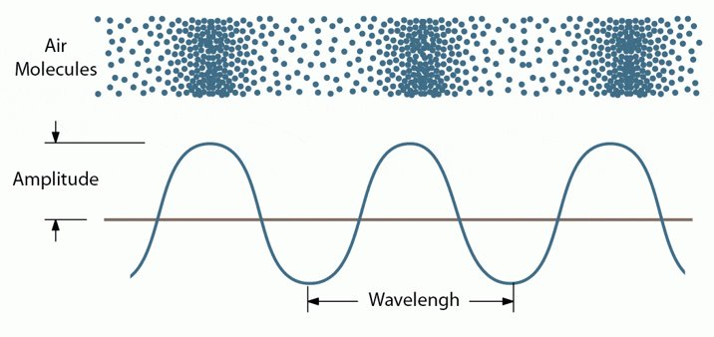
How Data is Encoded
Audio Files
Audio files are encoded through a two-step process: converting sound into a continuous electrical signal, and then converting that analog signal into a stream of binary data.
This digital data is then often compressed using a codec (coder/decoder) and placed within a container format (the file type, e.g., .WAV, .MP3) for storage or transmission.

Slide 13
1. Analog-to-Digital Conversion (Digitization)
The initial process involves converting physical sound waves into digital data using a technique called Pulse Code Modulation (PCM).
Capture: A microphone captures sound waves (vibrations in the air) and converts them into a continuous, varying electrical voltage signal (an analog waveform).
Sampling: An Analog-to-Digital Converter (ADC) measures the amplitude (loudness) of this analog signal at regular intervals. The sample rate determines how often these measurements are taken per second (e.g., 44,100 times per second for CD quality audio).
Quantization: Each sampled amplitude value is converted into a precise numerical value and stored as binary code (1s and 0s). The bit depth determines the precision of these numbers (e.g., 16-bit or 24-bit), affecting the dynamic range and fidelity of the sound.
The result is a raw, uncompressed stream of digital data, often stored in formats like WAV or AIFF files.

Slide 14
2. Compression (Using Codecs)
Because uncompressed files are very large, they are often processed further to reduce their size for easier storage and streaming. This is done using an audio codec:
Lossless Compression: This method is like zipping a file; it rearranges the data to use less space without permanently losing any information. When unpacked (decoded), the audio is an exact replica of the original digital recording. Examples include FLAC and Apple Lossless (ALAC).
Lossy Compression: This method uses psychoacoustic models to identify and permanently remove sounds that humans are least likely to hear (e.g., very high frequencies, or quiet sounds masked by louder ones). This results in significantly smaller file sizes, but some data is permanently lost, reducing quality. MP3 and AAC are common examples.
The final encoded digital data is then placed into a container format, which adds metadata like the song title, artist, and file length, creating the final audio file you use.

Slide 15
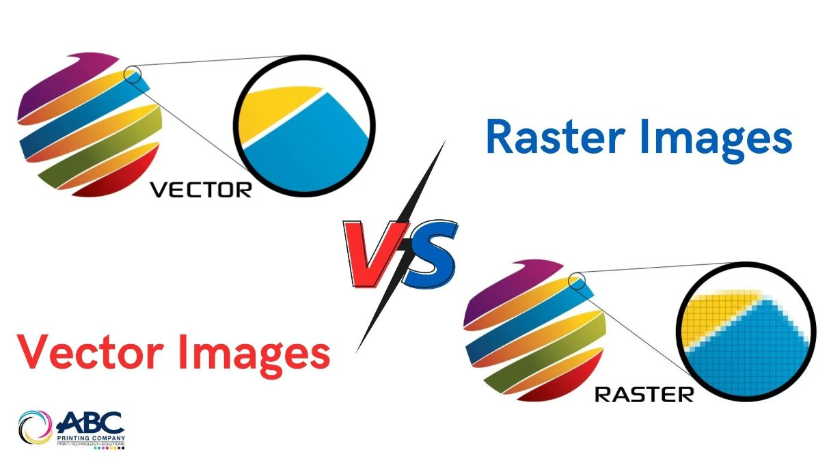
How Data is Encoded
Image Files
Vector Images
A vector file stores mathematical descriptions of shapes, not pixels. The file contains text-like commands, such as:​
Draw a circle at (200, 200) with radius 50 and color blue​
Raster image:​
A raster image is made of pixels, and each pixel has a color. That color is stored as numbers (usually RGB values), and those numbers are stored as binary.

Slide 16

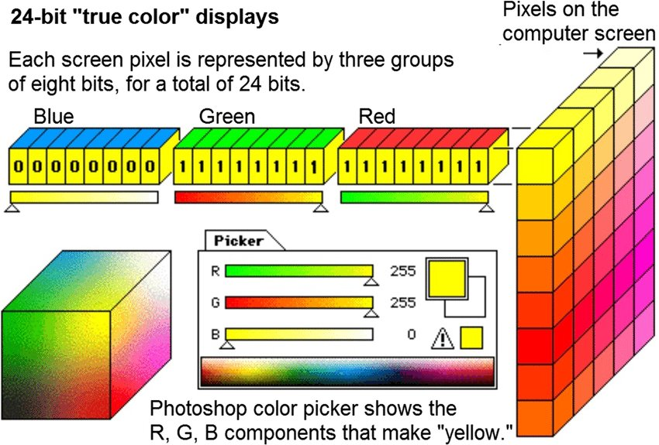
Raster image​

Slide 17
File Compression
To compress a file means to reduce its size by using an algorithm to remove redundant data, which saves storage space and makes the file faster to transfer over a network.
The process is reversible, allowing you to "uncompress" or "unzip" the file to restore it to its original state and quality.
Common methods include
Lossless compression, preserves all original data and quality. Some file type examples ZIP, PNG, GIF, FLAC
Lossy compression, can significantly reduce file size by permanently removing some data that is less noticeable to humans. Some file type examples MP3, JPEG, MPEG
The compressibility of data depends on the structure of the file, the type of content it holds, and the compression algorithm used. ​
Some types of data compress much better than others, while some types may not benefit much from compression at all.

Slide 18
Lossless​
Different file formats rely on different compression algorithms to reduce file size. some commonly used lossless compression algorithms:
Redundancy reduction (Run-Length Encoding)​
Compresses data by replacing consecutive repeated values with a single value and a count.​
Dictionary based methods​
Replace repeated patterns in data with shorter codes stored in a dictionary, allowing recurring sequences to be represented efficiently.

Slide 19
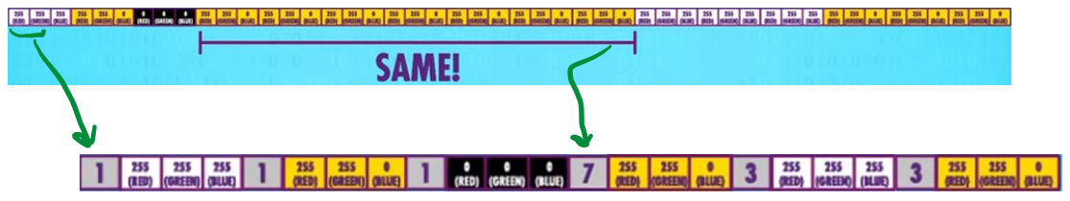
Redundancy reduction​
Repeating patterns are replaced with shorter representations​
Example: AAAAABBB → 5A3B (Run-Length Encoding)
Below is part of an image file content where the color of each pixel is shown. Instead of storing each repeated color individually (top image).
We can use Run-length Encoding to store the count of consecutive patterns (bottom image)

Slide 20
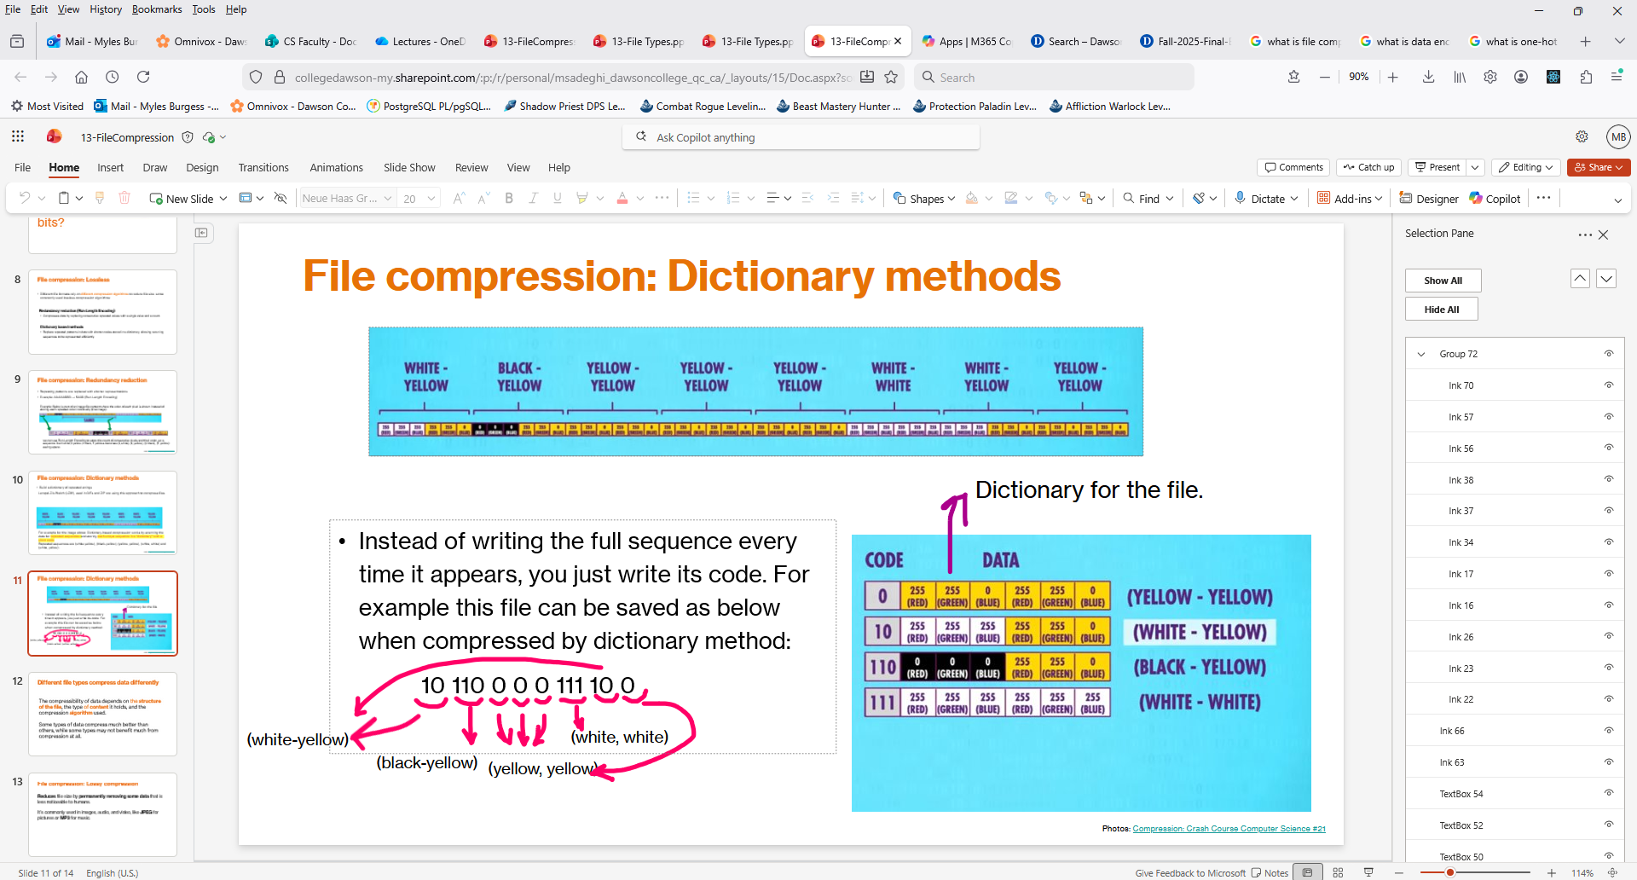
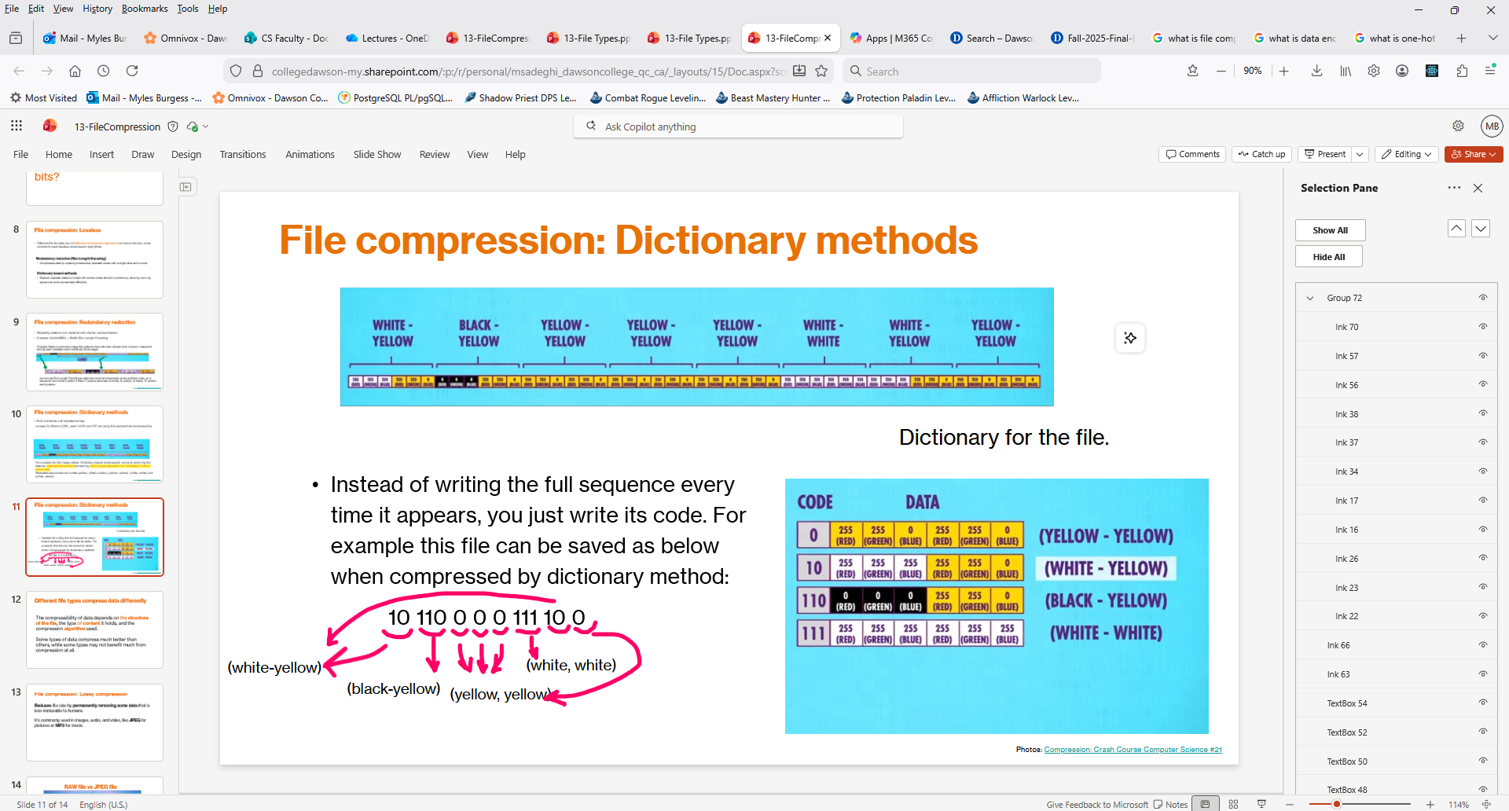
Dictionary methods
Dictionary-based compression works by scanning the data for repeated sequences and storing each unique sequence in a “dictionary” with a short code. ​
In the image below repeated sequences are (white-yellow), (black-yellow), (yellow, yellow), (white, white) and (white, yellow). These can be stored in a dictionary and the instead of writing out the full sequences each time we write the code for the sequence instead.
This data would look like this
10 110 0 0 0 111 10 0
Dictionary

Slide 21
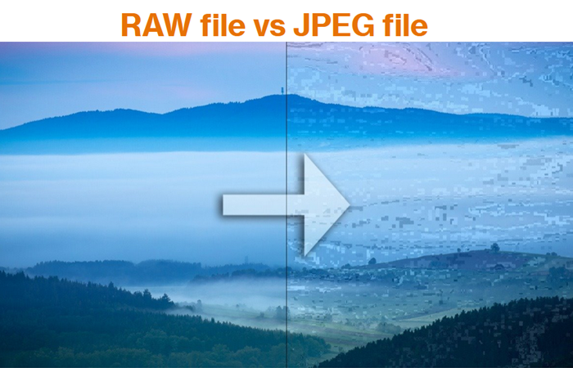
Lossy compression
Lossy compression is a data compression method that reduces file size by permanently discarding some of the original data.
This process is irreversible, meaning the original file cannot be fully restored, but it allows for significantly smaller file sizes by removing information that is considered less important or imperceptible to human senses.
It is commonly used for media like images (JPEG), audio (MP3), and video, where a slight loss in quality is often acceptable.

Slide 22
Do pages 39 to 43 in your work book

